Slide 1

WELCOME TO MY WORLD
PRESENTATED TO YOU BY SAMANTHA LAND

Slide 2
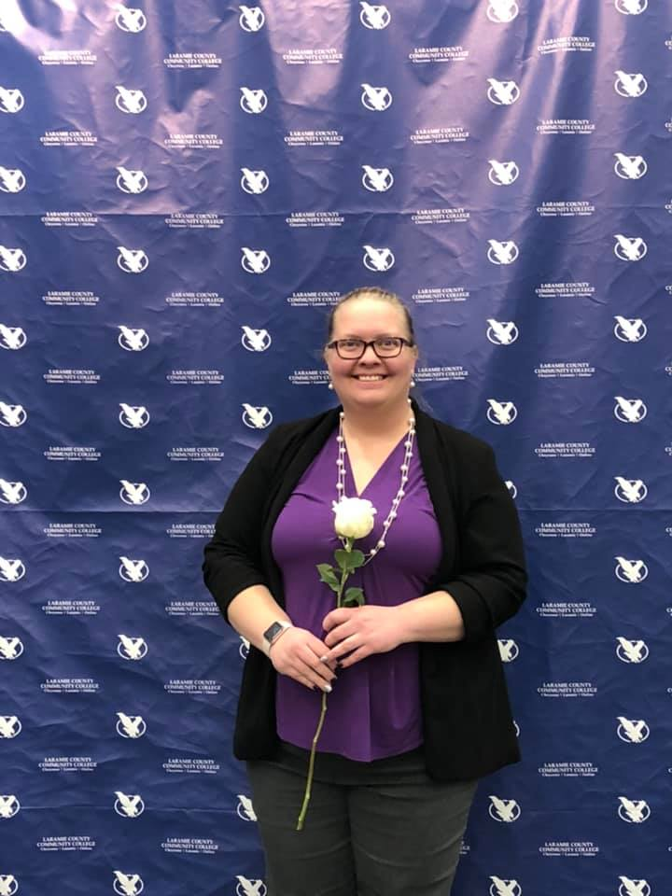
LIFE AS A COLLEGE STUDENT
GOALS
  GRADUATE SPRING 2020
    DUAL MAJOR – ACCOUNTING AND BUSINES/FINANCE
  BEGIN UNIVERSITY OF WYOMING FALL 2020
    MAJOR – ACCOUNTING
CLUBS
  ROTORACT
  PTK
    HONORS IN ACTION

Slide 3
MY CAREER
CABELA’S
  ACCOUNTING SHEARED SERVICE 2008-2016
CHEYENNE REGIONAL MEDICAL CENTER
  CNA 2016-2018
  BILLING ASSISTANT 2017-2018
MHP,LLP
  ACCOUNTANT TECHNICIAN 2018-PRESENT

Slide 4
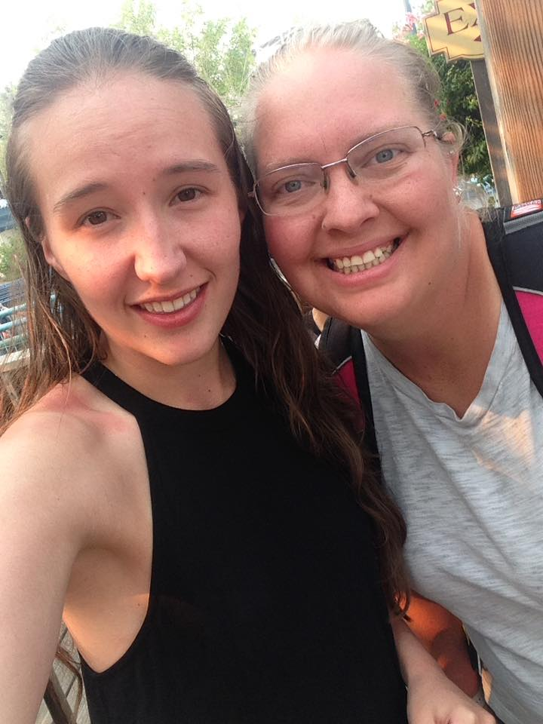
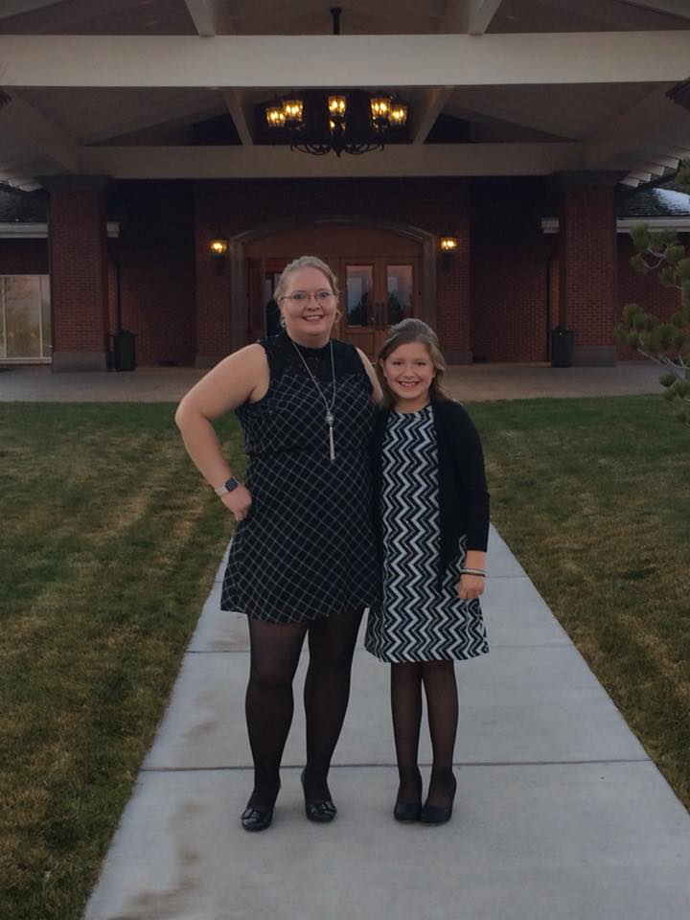
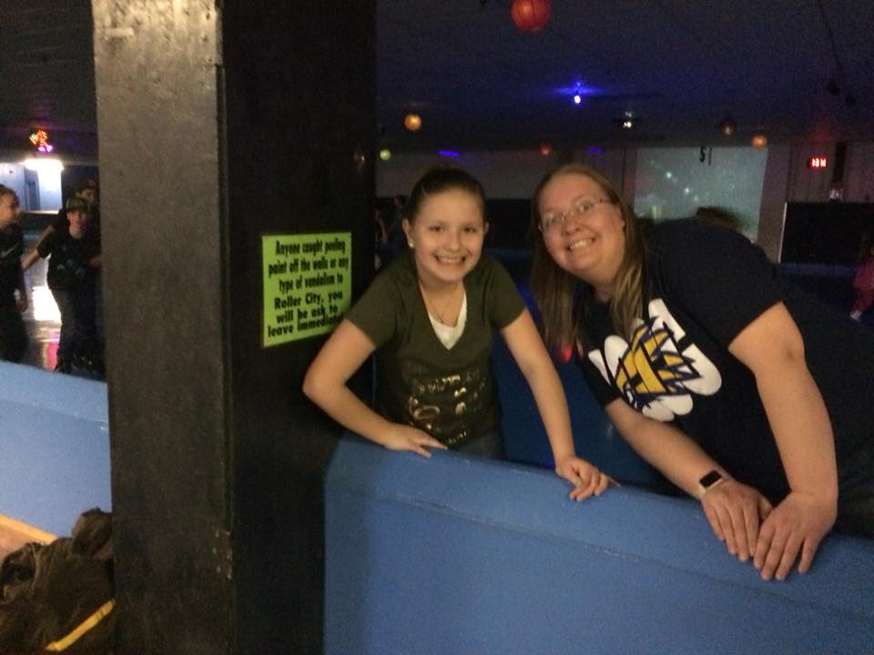
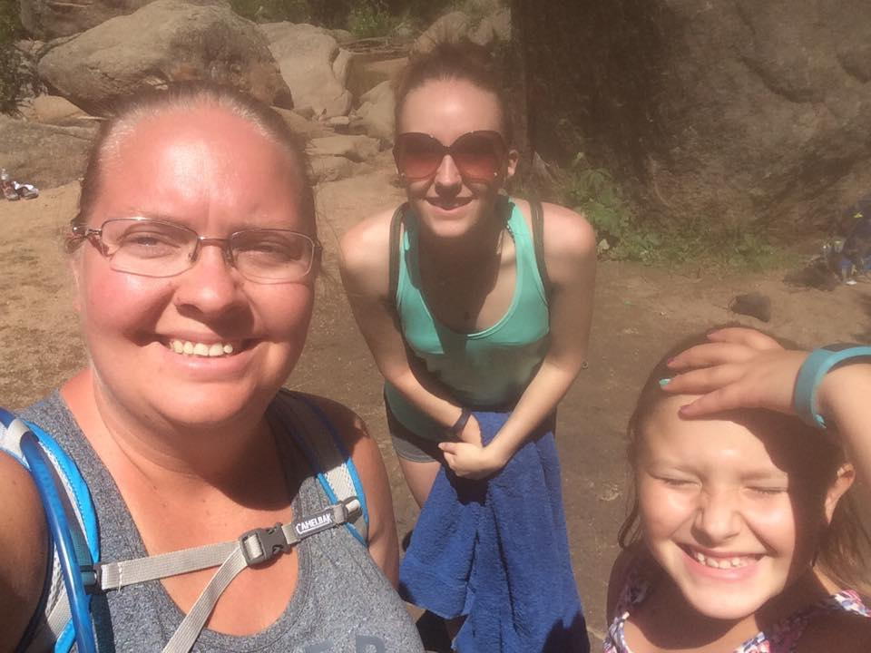
MY FAMILY

Slide 5
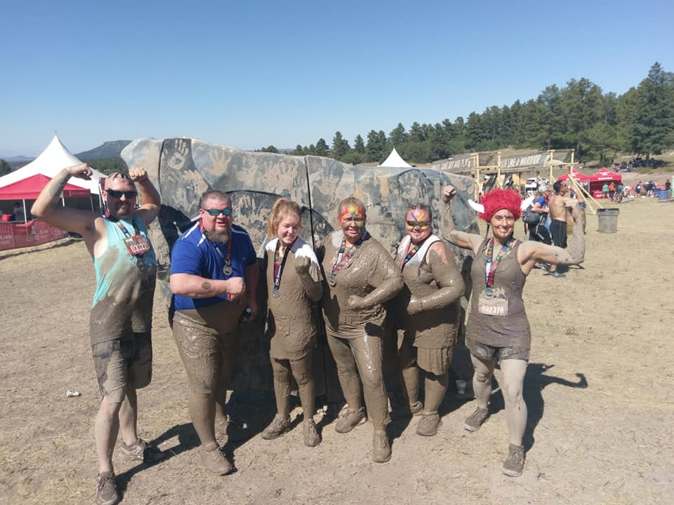
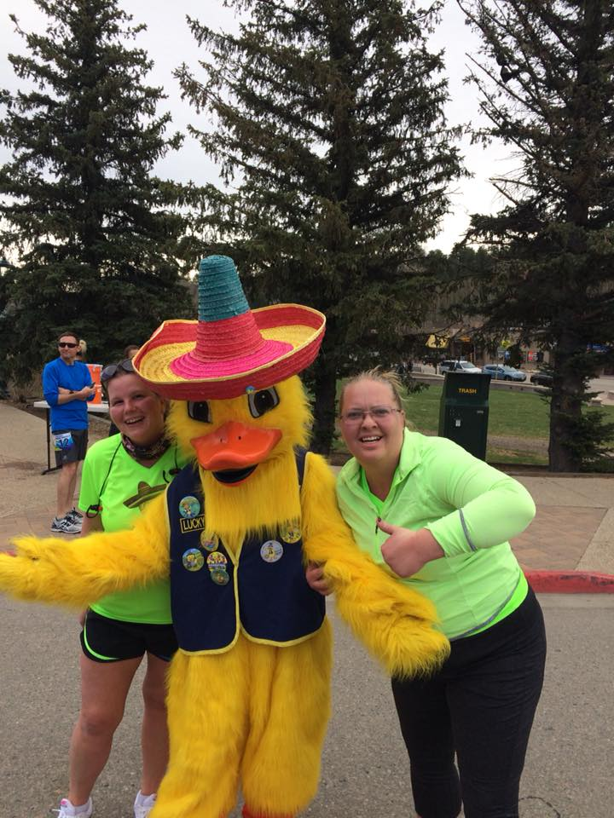
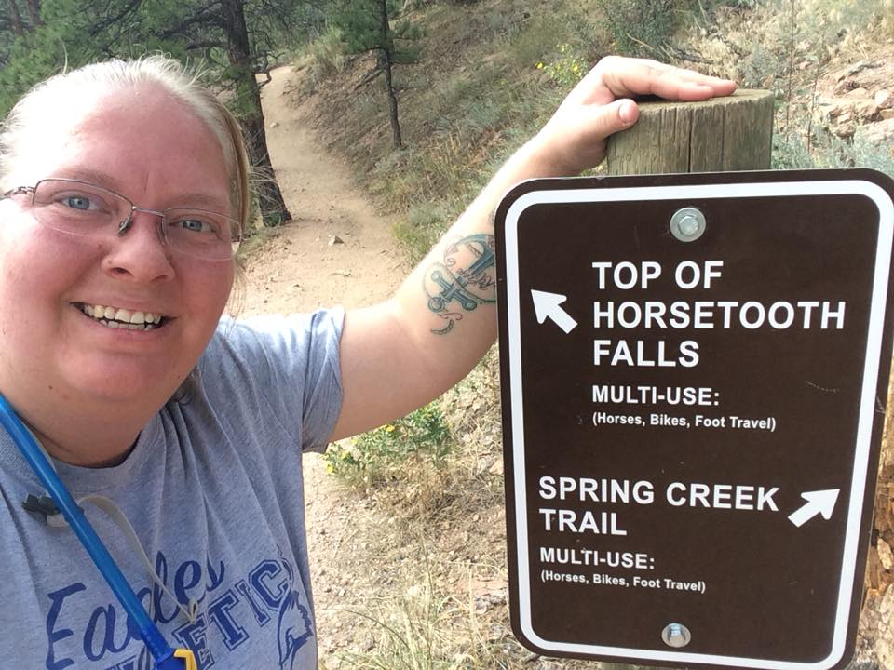
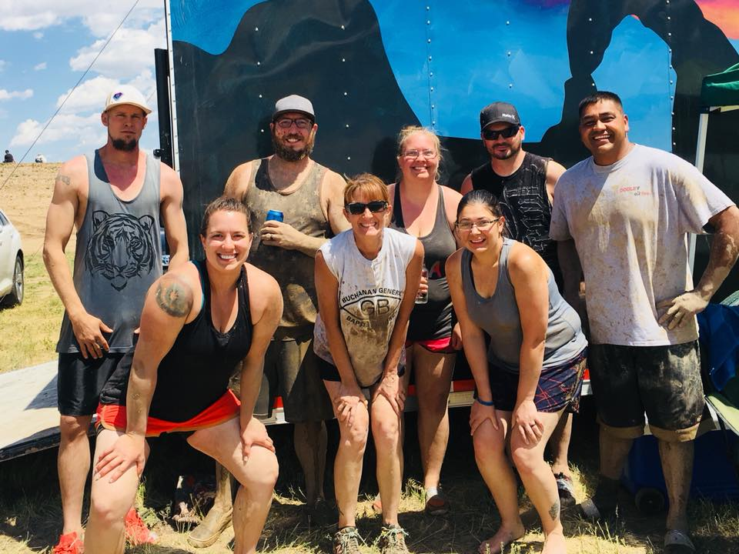
HOBBIES AND OTHER ACTIVIES
SPORTS
HOBBIES
VOLLEYBALL
SOFTBALL
  SHORT-STOP
RUN/WALKING 5K’S
TOUGH MUDDERS
SPARTAN
WARRIOR DASH
HIKING

Slide 6
IT WAS NICE MEETING YOU ALL AND THANK YOU!!!

Slide 7
REFERENCE
Figure 1. Samantha Land, Cheyenne, WY. March 5, 2019.
Figure 2. Self Portrait of Dana Windsor and Samantha Land, Denver, CO. May 20, 2018.
Figure 3. Cadance Land and Samantha Land, Cheyenne, WY. February 25, 2018.
Figure 4. Cadance Land, Samantha Land, and Dana Windsor, Curt Gowdy State Park, WY. May 13, 2018.
Figure 5. Cadance Land and Samantha Land, Cheyenne, WY. November 11, 2018.
Figure 6. Crystal Church and Samantha Land, Estes, CO. May 5, 2018.
Figure 7. Amanda Trammell, Ben Trammell, Brandy Moralez, Greg Lang, Jessica Lang, and Samantha Land. Larkspus, CO. September 15, 2018.
Figure 8. Adam Everitt, Zane Rogers, Brittany Rogers, Mike Hames, Migule Reyes, Mackenzie Lazer, Brenda Lynn and Samantha Land, Cheyenne, WY. July 14, 2018.
Figure 9. Self portrait of Samantha Land, Fort Collins, CO. August 26, 2018.

